Slide 1
MISSION INDONESIA
THE VISION
PROCLAIMING THE GOSPEL TO EVERY VILLAGE, TOWN AND CITY IN INDONESIA
For the Son of Man has come to save that which was lost. Mat 18:11
This is good and acceptable in the sight of God our Savior, who desires all men to be saved and to come to the knowledge of the truth. 1Ti 2:3-4
Notes:
This is the vision of God for the church

Slide 2
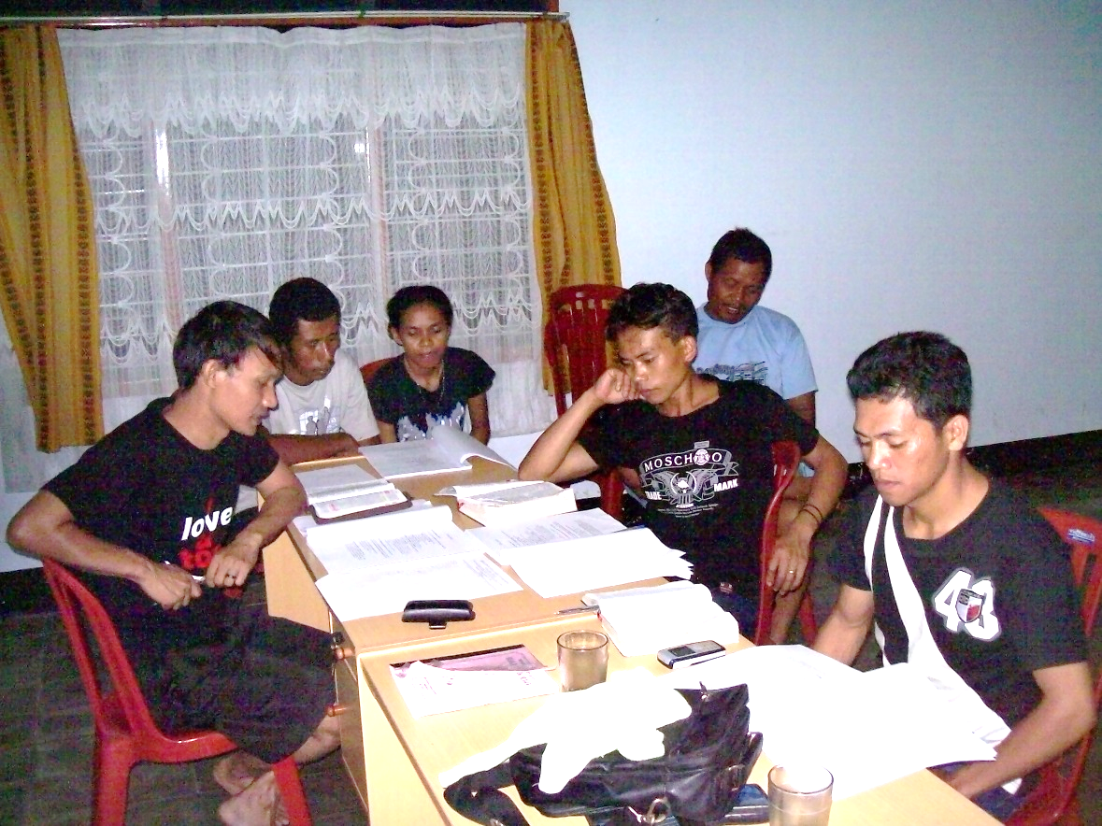
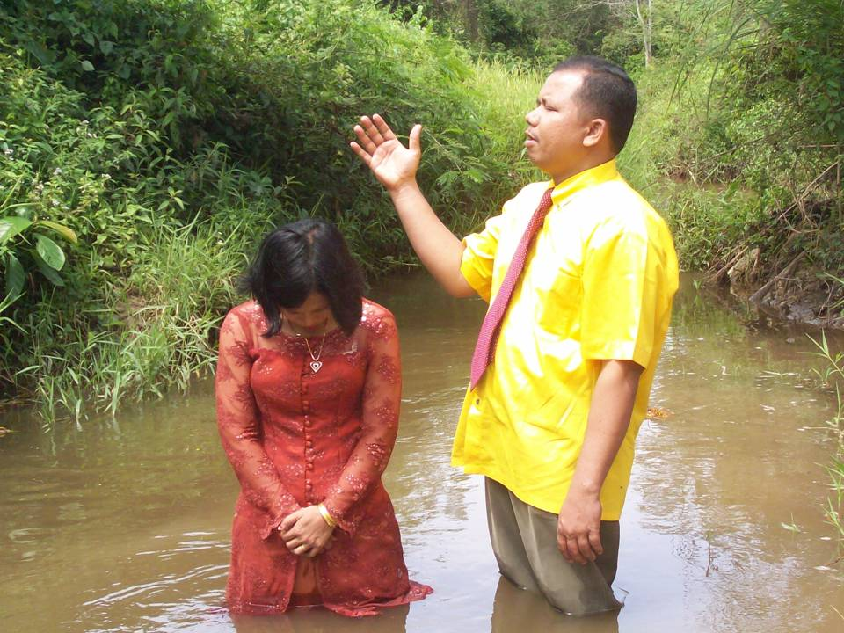
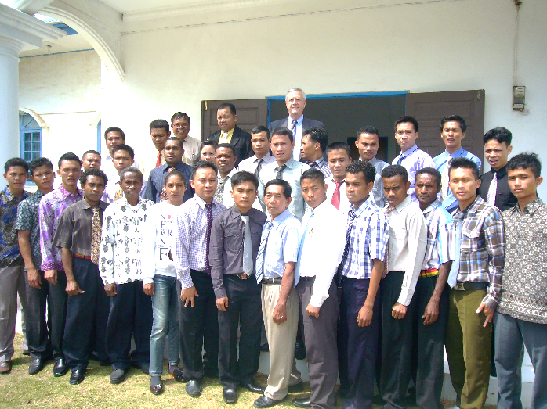
MISSION INDONESIA
The Biblical Method For Fulfilling The Vision Is
Matthew 28:18-20; 4:19
Notes:
Jesus gave the vision and gave us the method for doing it.

Slide 3
MISSION INDONESIA
63 CHURCHES PLANTED
1600+++ BAPTIZED SINCE 2000
50 MILLION
14 MILLION
18 MILLION
4 MILLION
141 MILLION
Notes:
We already have laid the foundation to accomplish the vision

Slide 4
MISSION INDONESIA
CHURCH DEVELOPMENT BY DISCIPLESHIP
MAT. 28:18-20 AND MAT. 4:19
A DISCIPLE
Knows and follows Christ
Being changed by Christ
Committed to the mission of Christ
Passive To Active
Dependent to Empowered
Acquaintances to Loving One Another
Accepts responsibility for Christ’s Mission
Notes:
This is what we can do and be when we follow Jesus

Slide 5
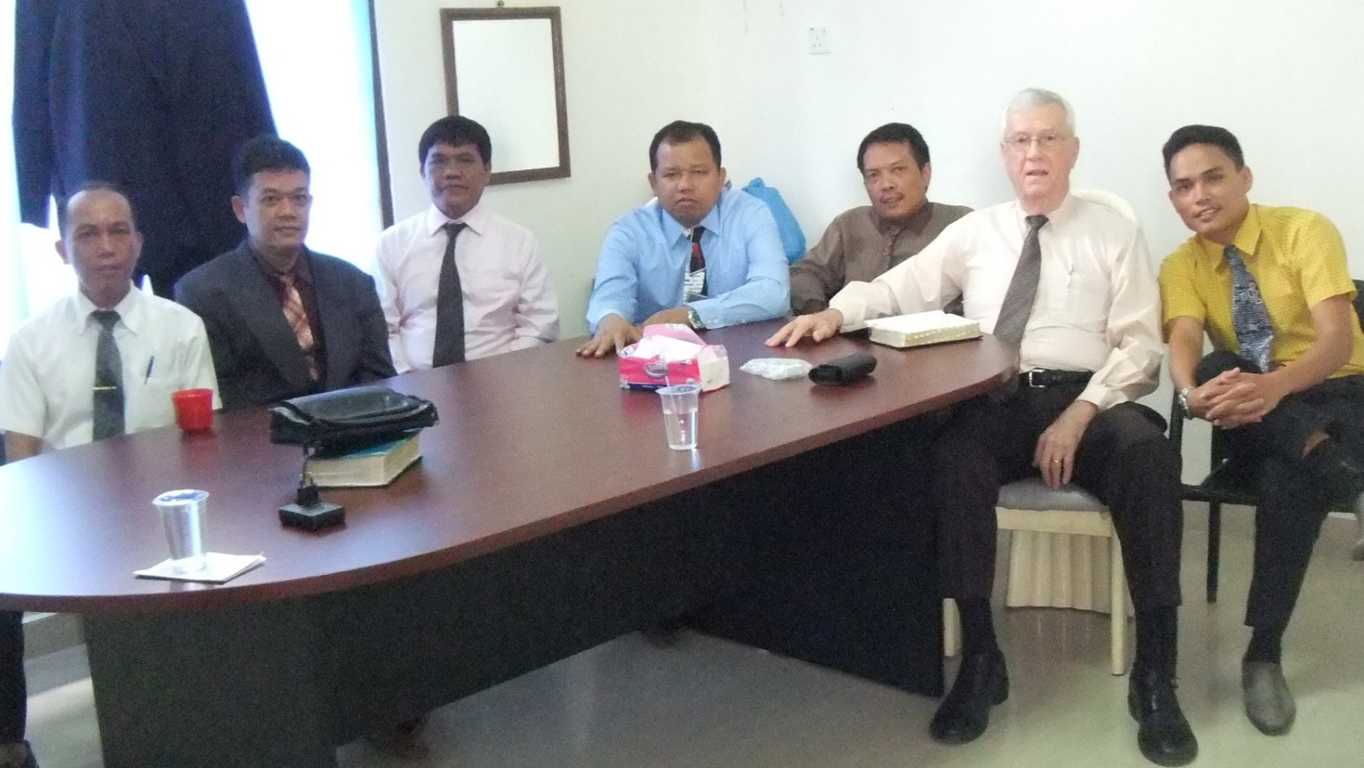
MISSION INDONESIA HOW DO WE MAKE DISCIPLES? THE SAME WAY JESUS DID!
In Small Groups
The discipleship group in Batam
That are accountable, intentional, and relational
Notes:
The practical application of Mat 4:19

Slide 6
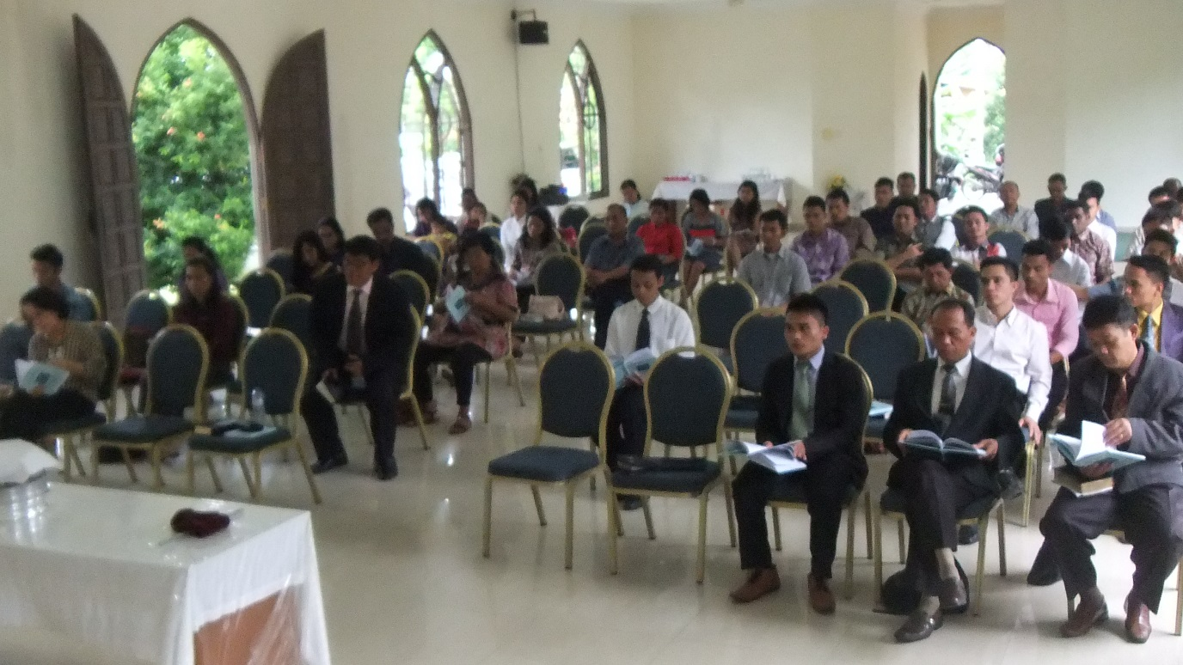
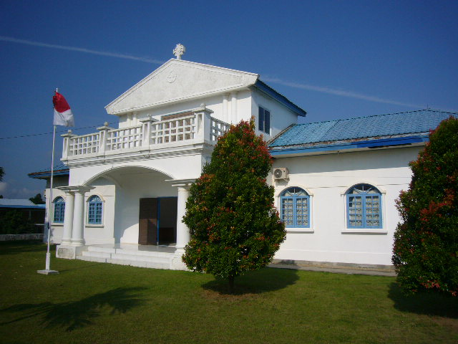
MISSION INDONESIA HAS TWO PARTS
CHURCH PLANTING & DEVELOPMENT
BATAM
BIBLE COLLEGE
Notes:
Mission Indonesia has established the foundation for fulling the vision through

Slide 7
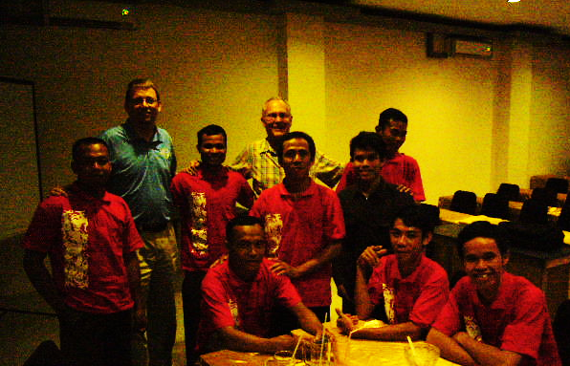
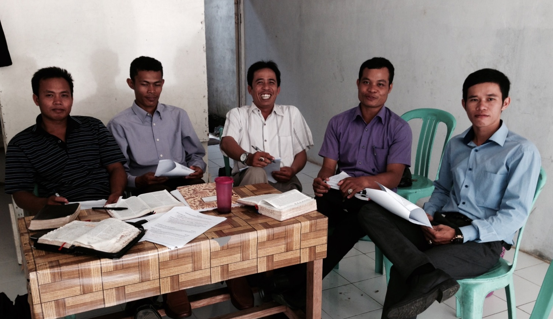
MAKING DISCIPLES
MISSION TEAM WEST, KALIMATAN
DICIPLESHIP GROUP
IN PONTIANAK, KALIMATAN
Notes:
Here you see the vision being spread to Kalimatan where 9 churches have been planted

Slide 8
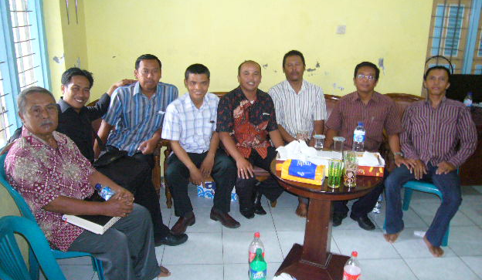
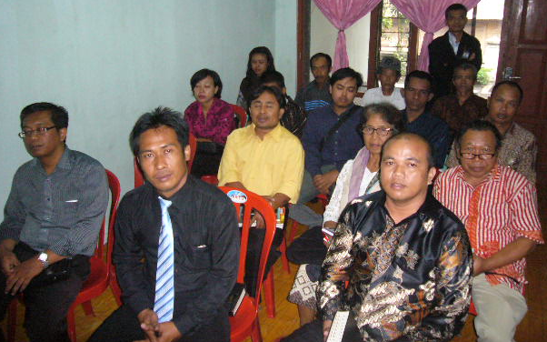
MAKING DISCIPLES
DISCIPLESHIP GROUP SOLO, CENTRAL JAVA
NEW CONGREGATION SALATIGA, CENTRAL JAVA
STUDENT APPRENTICESHIP PROGRAM
Notes:
From Kalimatan to Java the vision is spreading

Slide 9
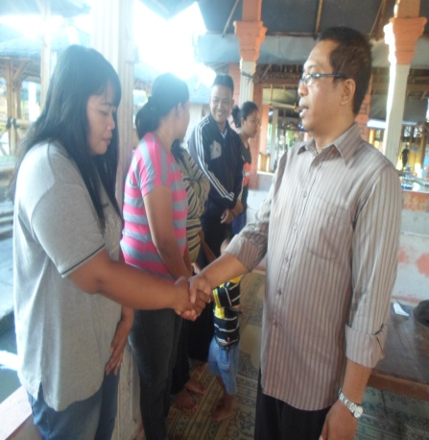
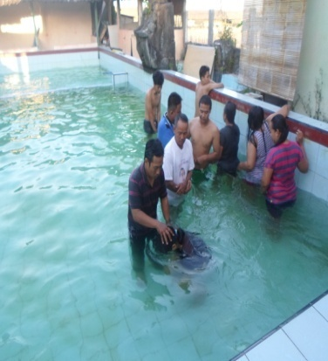
IN SANGGRAHAN, JAVA
2 Muslims - 2 unchurched - 9 w/ Christian backgrounds
This month, we try to open a church in the village of SUKOHARJO.
Can Mr. Winston supply Rp1 MILLION $74/mon. for the work there?
Can Mr. Winston add to the salary of Bro. David as he works very hard? Please add RP500,000 ($40) to his current salary of $112.00.

Slide 10
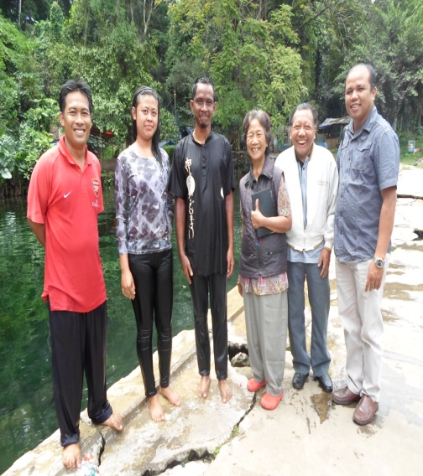
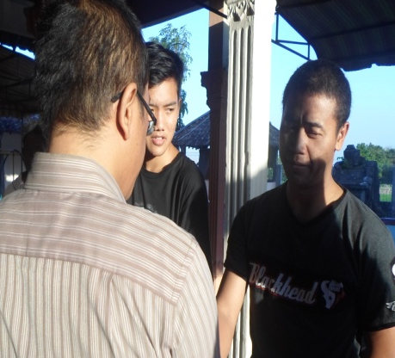
MUSLIM CONVERTIONS
SALATIGA
Dian & Katrine
SANGGRAHAN Dwi Anton & Rina
SOLO Rina understand about the Gospel and Salvation. She is ready to receive Jesus Christ. But her struggle is her family (her sister).
SUKOHARJO – Opened a small group here but difficult as it is a city of Islam. There are 8 persons in the group and 3 are Muslims.
Notes:
Rina popular name,

Slide 11
STORY OF RINA IN SANGGRAHAN
Rina graduated from an Islamic school. So she understands about Islam but her knowledge about Islam makes her confused. She explained to us, she is confused about salvation. She tried looking for Salvation in Quran, but she is didn’t find a GUARANTEE OF SALVATION.
She was confused about the SCALE of JUSTICE. How do we know that the reward is better than the sin. So the SCALE can’t give any certainty.
She was confused about the contradiction between QURAN with HADIS and SUNNAH. For the example: In Quran no one can be Equitable or Just. But in the Hadis, men can have many wives so the Quran is not consistent.
She also believes about the end of the world. According to the Quran, doomsday will happen when Jesus come again. So she wanted to understand about Jesus, especially His dying on the cross. She does not believe good works will save her.

Slide 12
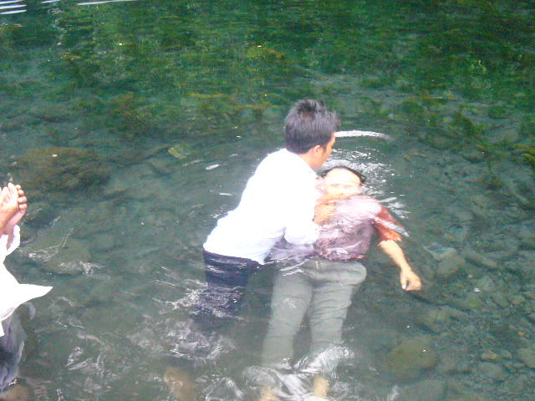
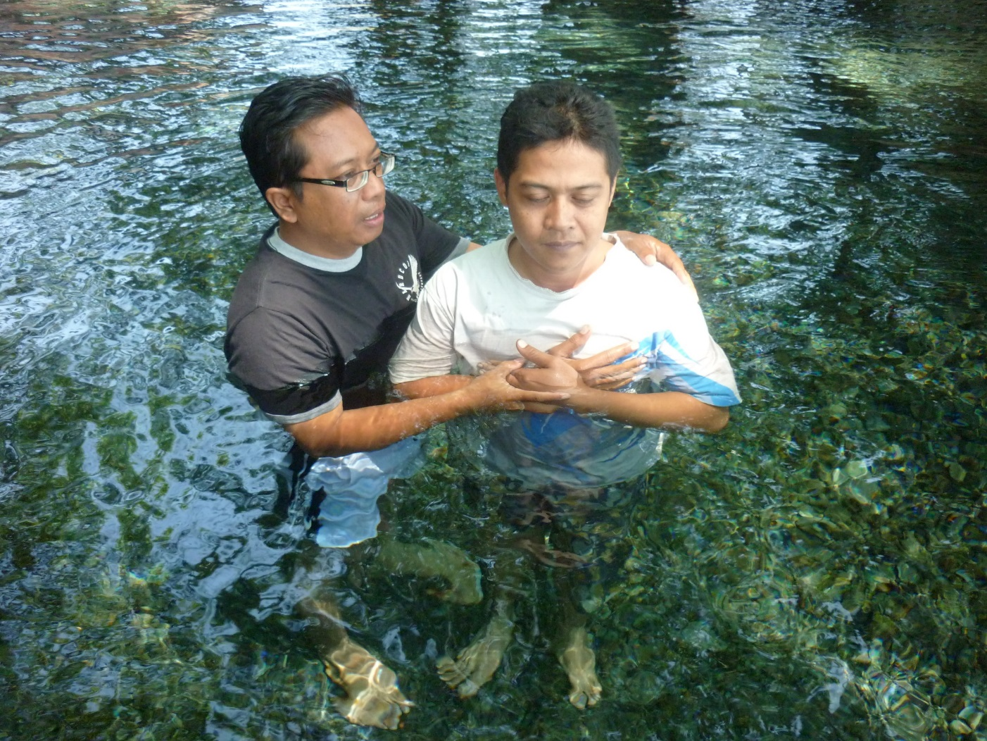
THE RESULT IS BAPTISMS

Slide 13
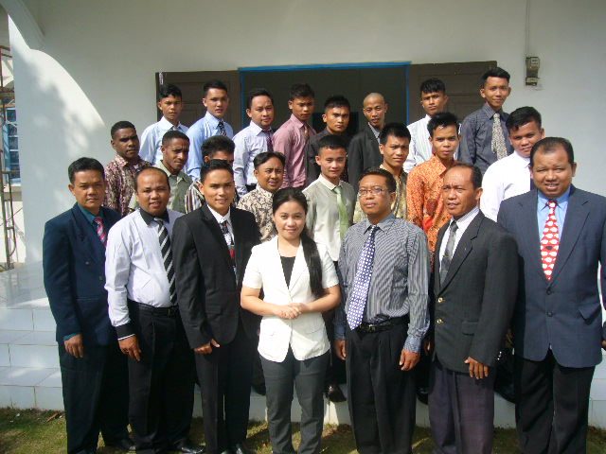
TEACHING THEM ALL I HAVE COMMANDED YOU
BATAM BIBLE COLLEGE CLASS
OF 2015

Slide 14
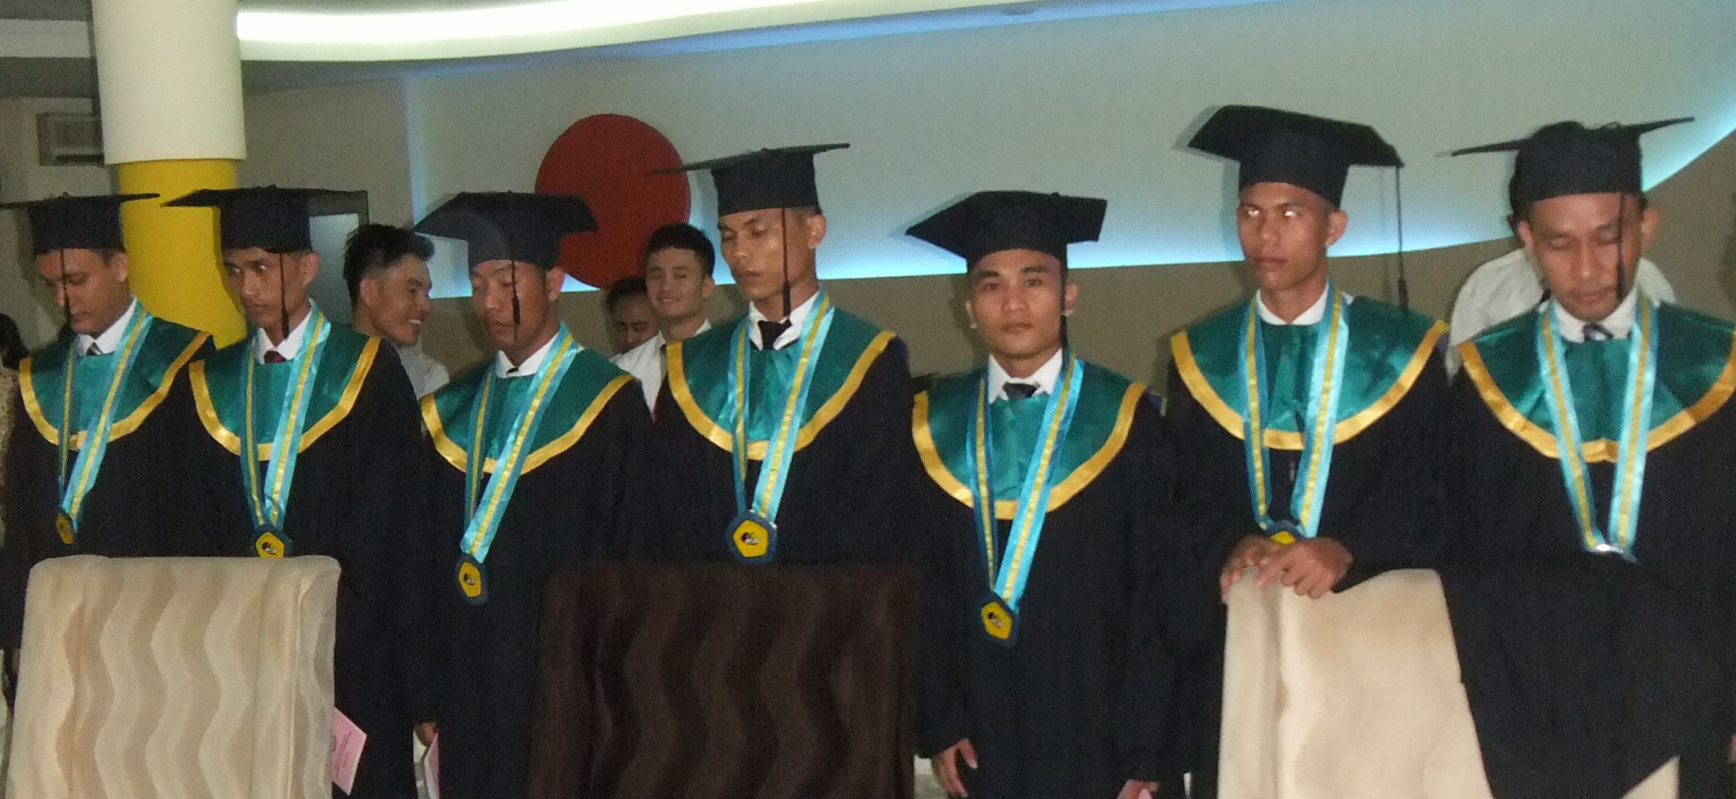
GRADUATION 2015 BATAM BIBLE COLLEGE

Slide 15
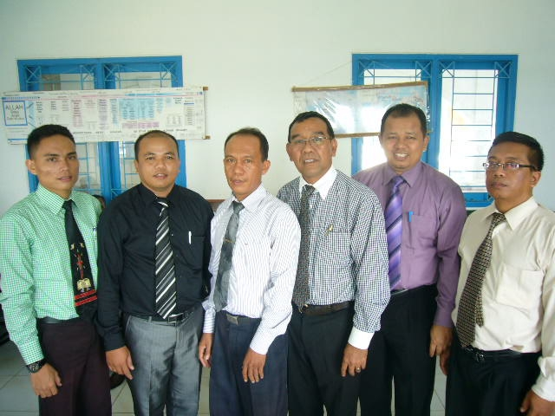
BATAM BIBLE COLLEGE
10,000 Sq. Ft.
Library
3000 Books
3 Class Rooms
Seats 70
Dorm Rooms
For 40 students
Offices for entire staff
Kitchen
TEACHING STAFF
3 - PH.D.
5 - MASTERS
3 - BACHEORS
Accredited To Bestow A Bachelors Degree In Biblical Theology

Slide 16
OPERATIONAL COST 2016
CHURCH DEVELOPMENT & PLANTING BUDGET
TOTAL COST $55,000
FUNDS NEEDED FOR 2015/16 $15,000
BATAM BIBLE COLLEGE BUDGET
TOTAL COST $90,700
FUNDS NEEDED FOR 2015/16 $20,000
ONE TIME NEED FOR 2015 $28,513

Slide 17
OPERATIONAL COST 2015
FINANCIAL STATEMENT
JULY 2015 SUMMARY
Batam Bible College $4825
Mission Teams $505
Winston Bolt $2552
FUNDS NEEDED FOR
Sept. – Dec.
Batam Bible College $19,201
Mission Teams $9,312
Winston Bolt $9,400
Golf Course Road church of Christ
3500 W. Golf Course Road
Midland, TX 79703
SEND TO:

Slide 18
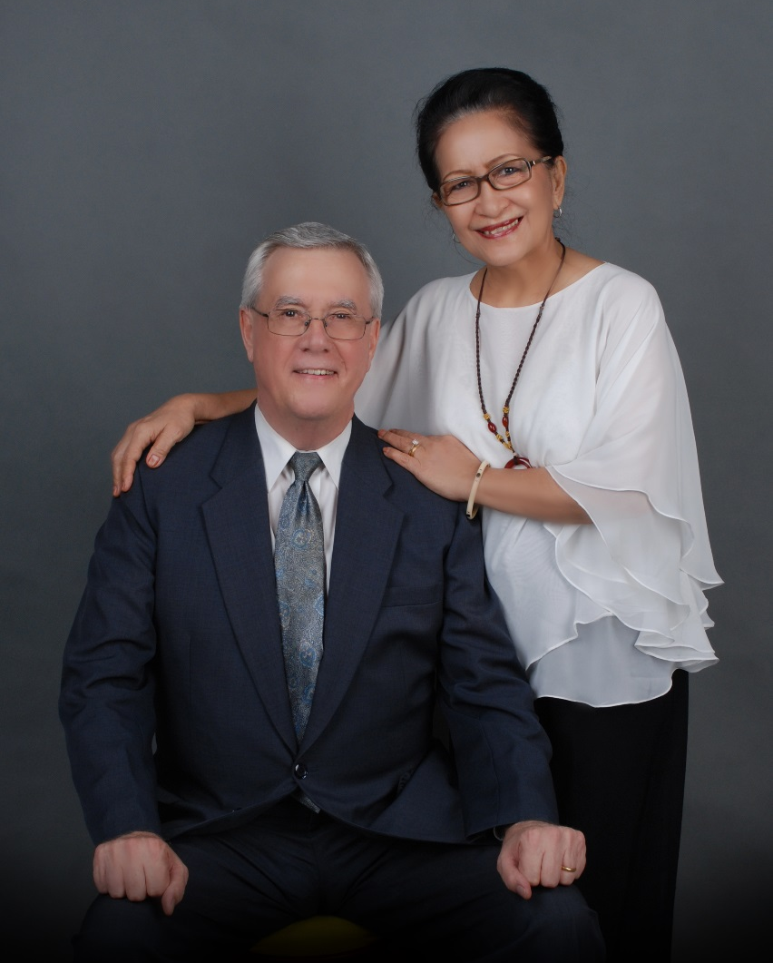
THANK YOU!
Lusi and I offer our deepest thanks to you and to our Lord for all that you and God have done for us.
For your faithful support, prayers and encouragement.
God Bless You All

Slide 19
For GCR
Pak Winston,
Thank you for the note and I can understand right now. The key point is we have to use money more wisdom on our budget in 2016 and recognize the boundaries of it. We appreciate of your efforts to cover the budget for this year and help you in a fervent praying so that God open the door of heart of brethren there to help.
Thanks,
Herbin

